Slide 1
Using TPUs for Computer Vision
Kaggle Days Meetup - Delhi NCR Dimitre Oliveira
7th, November, 2020

Slide 2
About me
Data scientist at Virtus, UFCG
Computer Science B.Sc. at UFCG
Kaggle Master
Kaggle competition TPU stars award
How to reach me: LinkedIn: /dimitre-oliveira-7a1a0113a Kaggle: /dimitreoliveira GitHub: /dimitreOliveira Medium: @dimitreoliveira

Slide 3
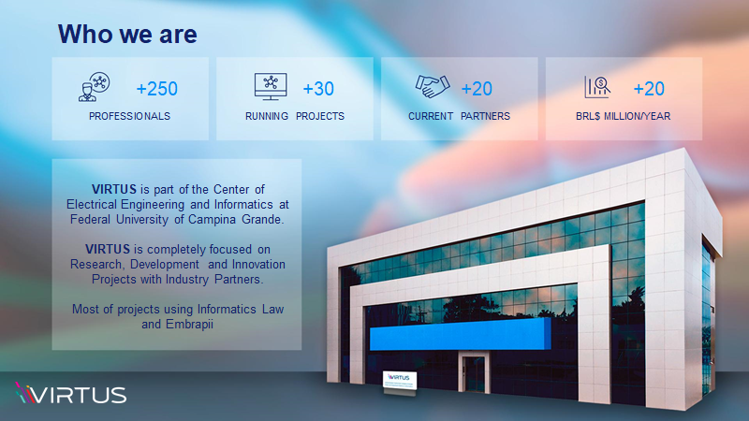
Virtus slide 01

Slide 4
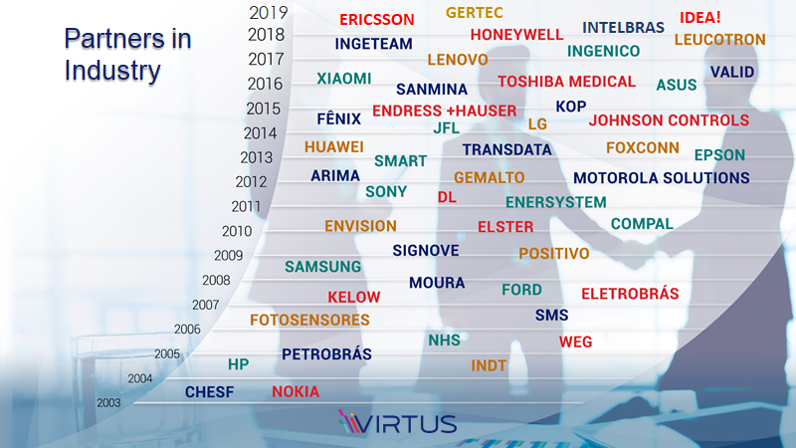
Virtus slide 03

Slide 5
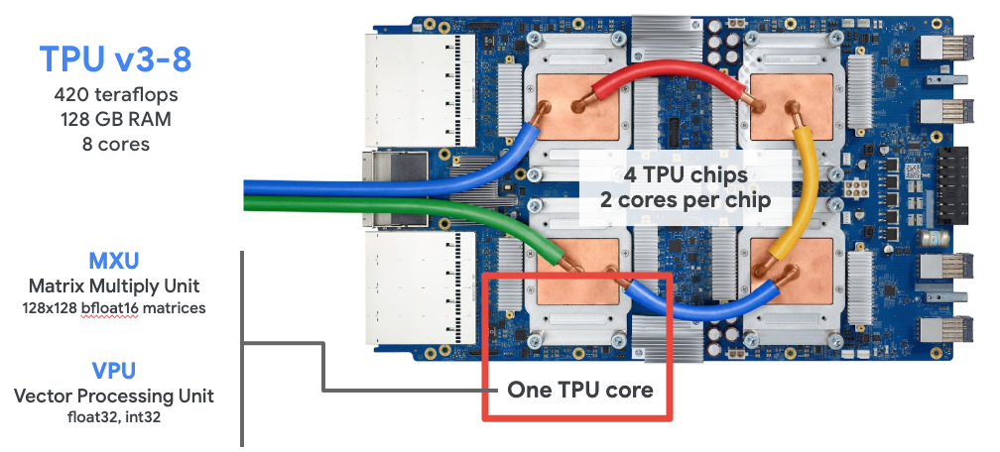
TPU introduction
Notes:
- TPU is short for Tensor processing unit
- Specialized hardware for deep learning developed by Google

Slide 6
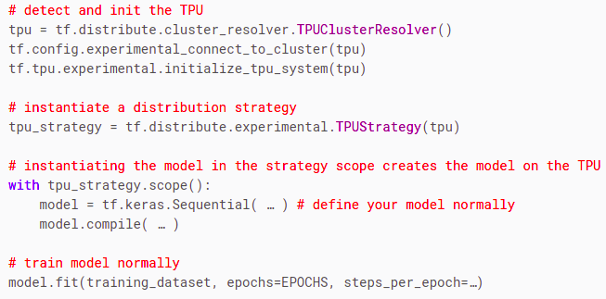
Starting with TPUs (simplified)
Notes:
- Simple integration with Tensorflow
- Low complexity (just a few extra lines of code)

Slide 7
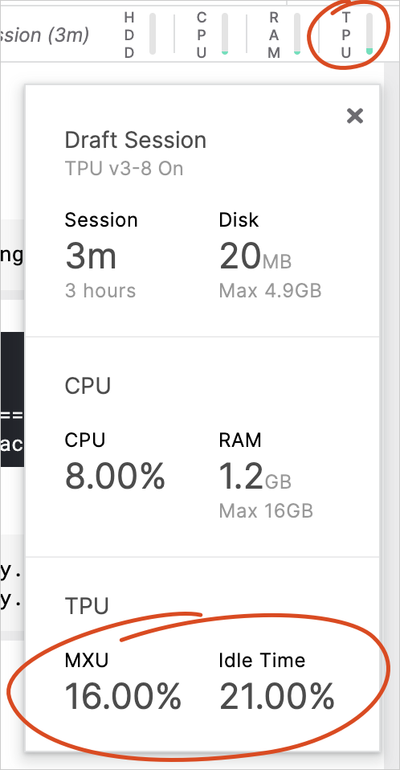
Tips for using TPU
Big batch size to take advantage of the TPU
Ideal size is 128 per TPU core (1024 global batch size)
Good size varies from 8 to 128 (per TPU core)
Remember to also scale the learning rate
Keep the TPU busy
Using tf.data and TFRecords
Monitor the TPU usage (Kaggle)
MXU means efficiency usage
Notes:
- tf.data and TFRecords to make a faster data pipeline (avoid data bottleneck)
- MXU percentage (keep high)
- Idle time (keep low)

Slide 8
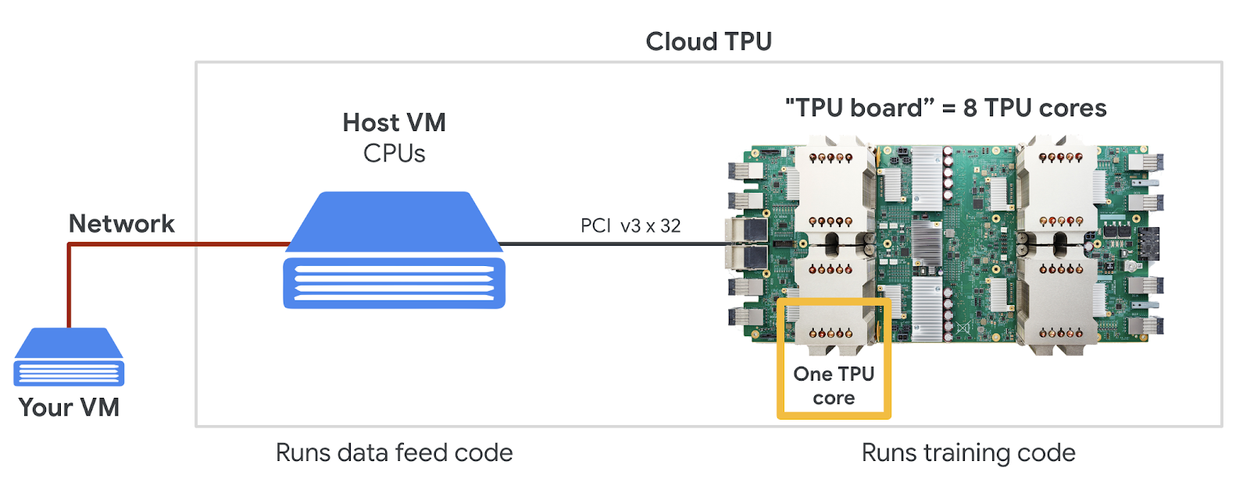
TPU common mistakes
Batch size too small
Data bottleneck feeding the TPU
Using appropriated learning rate (distributed system)
Notes:
- Data bottleneck (model runs batch faster than CPU feeds the data)
- Learning rate (distributed system and scale with batch)
- TPU runs on a different VM (remotely)

Slide 9
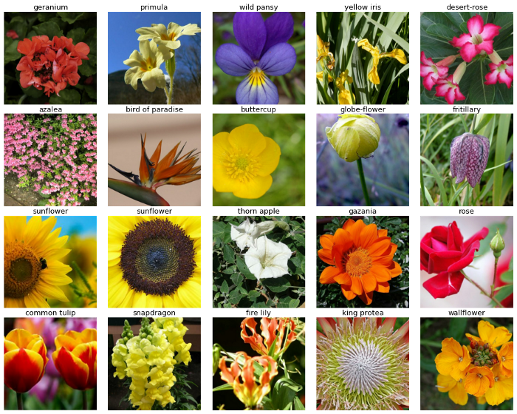
Notebook use case overview (data and task)
Dataset: Flowers dataset Train samples: 16465 Test samples: 7382 Image resolution: 192, 224, 331, 512
Task: Image classification (104 types)
Notes:
- Images drawn from five different public datasets
- The dataset contains imperfections (images of flowers in odd places, angles, etc)

Slide 10
Notebook walkthrough
Kaggle notebook: Flower Classification with TPUs - EDA and Baseline

Slide 11
Notebook quick recap
Initialized the TPU system
Defined all model and data parameters
Loaded the dataset (GCS path)
Quick EDA
Create data pipeline (using tf.data)
Create model (EfficientNet B6)
Warm Up top layers
Training (exponential LR decay with warmup phase)
Model evaluation
Inspect predictions
Predict on test data
Notes:
- The data pipeline also has all the data ingestion, pre-process, augmentation, batching, and etc.

Slide 12
Notebook improvements
Using a larger model (can overfit)
Using higher resolution (can overfit)
Dealing with class unbalance
K-Fold cross validation (more resources)
Ensemble with other models (more resources)
Strong data augmentation
More data!
Notes:
- Larger models -> more parameters
- Higher resolution -> more data, which can leads to overfitting
- Class unbalance (over and under sampling, weighted loss or samples)
- Data augmentation can also decrease performance
- More data is not always possible

Slide 13
References and resources
Kaggle TPU documentation
Google cloud TPU documentation
Tensorflow quick guide on using TPU
Keras and modern convnets, on TPUs (by Martin Görner)
Kaggle TPU Youtube playlist
Efficiently using TPU for image classification

Slide 14

Q&A section

